Slide 1
Abstraction and Interfaces

Slide 2
Learning Objectives
Understand the concept and purpose of abstraction in OOP.
Declare and implement abstract classes and methods in PHP.
Define interfaces and implement them in classes.
Differentiate between abstract classes and interfaces.
Apply abstraction and interfaces in real-world scenarios.

Slide 3
What is Abstraction?
Abstraction hides unnecessary details and shows only the essential features.
It focuses on what an object does, not how it does it.
Achieved using abstract classes or interfaces.

Slide 4
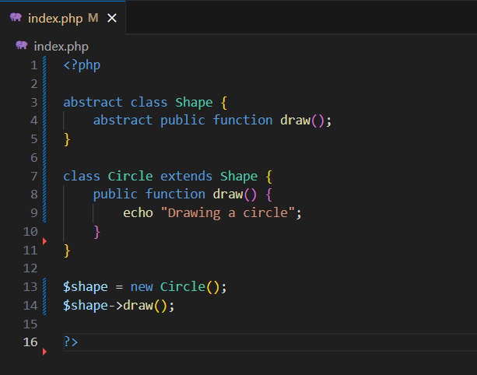
Abstract Classes
An abstract class cannot be instantiated directly.
Can contain both abstract methods (without body) and normal methods (with body).
Child classes must implement all abstract methods.
Notes:
We can’t create a Shape object directly because it’s abstract. But we can create a Circle (child class), and it must define how to draw().

Slide 5
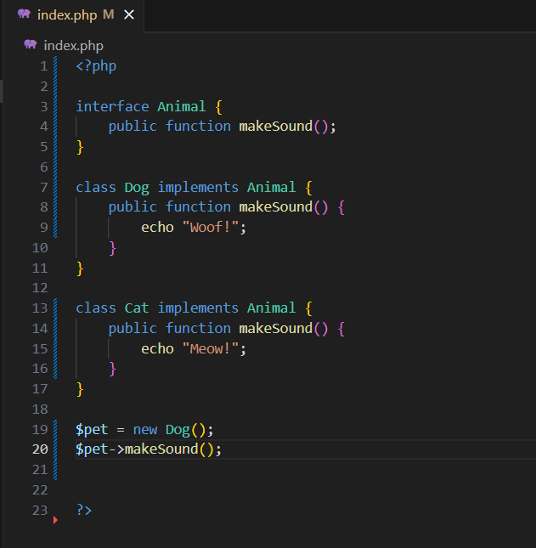
SAMPLE CODE

Slide 6
Abstract Classes vs Interfaces
Feature | Abstract Class | Interface
Can have method bodies | Yes | No
Can have properties | Yes | No
Multiple inheritance | One (Classes Only) | Yes (multiple allowed)
Purpose | Base class with logic | Strict contract/structure

Slide 7
Practical Applications
Scenario:
You’re creating a notification system with Email, SMS, and Push.
Create an interface Notifier with send().
Each class (EmailNotifier, SMSNotifier) implements Notifier.
Notes:
<?php
interface Notifier {
public function send($message);
}
class EmailNotifier implements Notifier {
public function send($message) {
echo "Sending Email: $message\n";
}
}
class SMSNotifier implements Notifier {
public function send($message) {
echo "Sending SMS: $message\n";
}
}
class PushNotifier implements Notifier {
public function send($message) {
echo "Sending Push Notification: $message\n";
}
}
function notifyUser(Notifier $notifier, $message) {
$notifier->send($message);
}
$email = new EmailNotifier();
$sms = new SMSNotifier();
$push = new PushNotifier();
notifyUser($email, "Welcome!");
notifyUser($sms, "Verification code: 1234");
notifyUser($push, "New message received");
?>
The Notifier interface ensures all classes have a send() method.
Each class (Email, SMS, Push) implements the method differently.
This allows us to use one function (notifyUser) for different message types — that’s polymorphism in action.

Slide 8
Summary
Concept | Key Point
Abstraction | Hides complexity, shows only what matters
Abstract Class | Partial class with shared code; not directly used
Interface | Set of required methods; no code inside

Slide 9
Thank you

